Slide 1


Group 1: Chung Yim Hung (Nicole) Chan Wing Ki (Teresa) Wong Wing Ying (Elaine)
Capstone Project on
iHerb Hair Care
Best Sellers Analysis
◆Scope:
Web Scraping, Data Visualization, Sentiment Analysis
◆Tools:
Selenium, BeautifulSoup, YData Profiling, PowerBI,
Natural Language Toolkit, Huggingface RoBERTa Transformers,
SciPy, WordCloud, TextBlob, Pandas, Numpy,
Regular Expression, Matplotlib, Seaborn

Slide 2
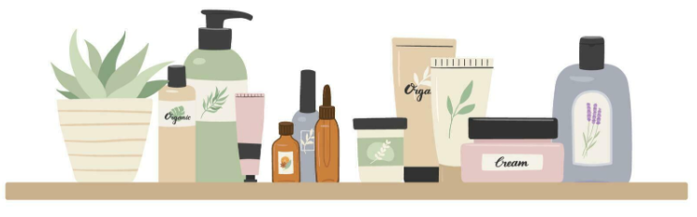
Agenda
01
Project Objective & Flow
02
Web Scraping (Product information & Customer reviews)
03
Data Preprocessing
04
Data Visualisation with a Dashboard
05
Sentiment Analysis on Customer Reviews
06
Conclusions and Future Work

Slide 3
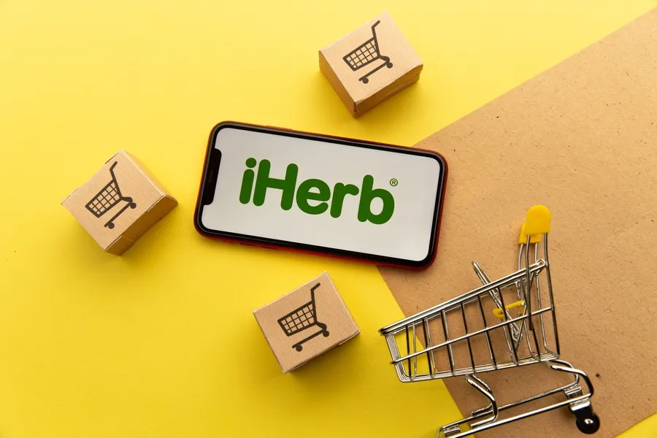

Project Objective
Get actual hair care products information and customer reviews
Analyze hair care best sellers from iHerb

Slide 4
Project Flow
01
Web Scraping
(Product information)
02
Data Preprocessing
03
Data
Visualisation
04
Web Scraping
(Customer reviews)
05
Text Preprocessing
06
Sentiment Analysis

Slide 5
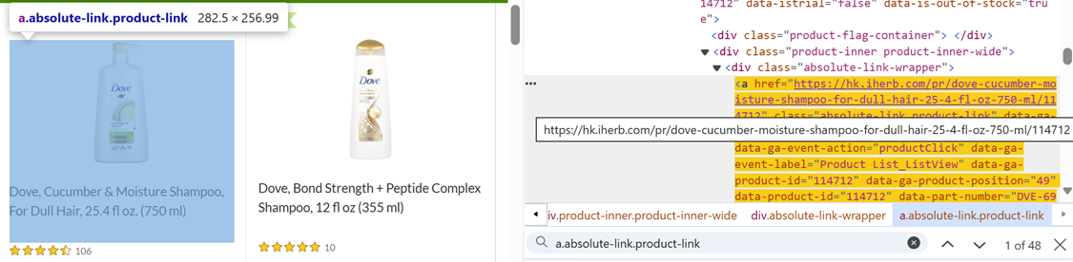
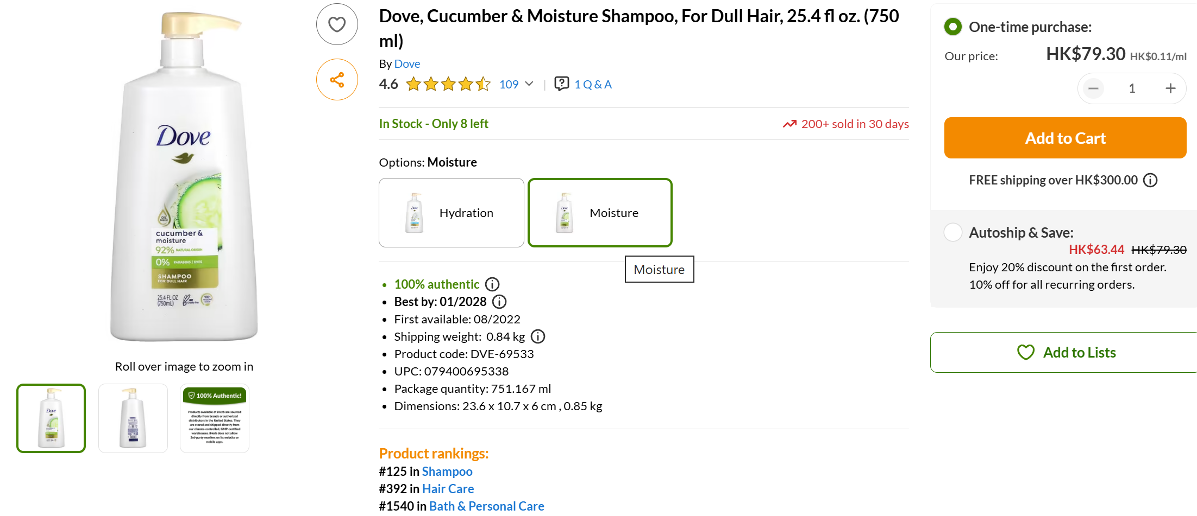
Scraping of Product Information
Tools: Selenium and BeautifulSoup
Process:
Defined a function to scrape data from a product page at each iteration
Saved the scraped data into a CSV file

Slide 6
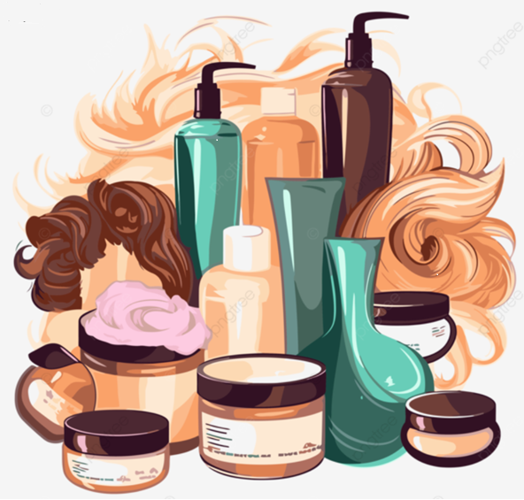
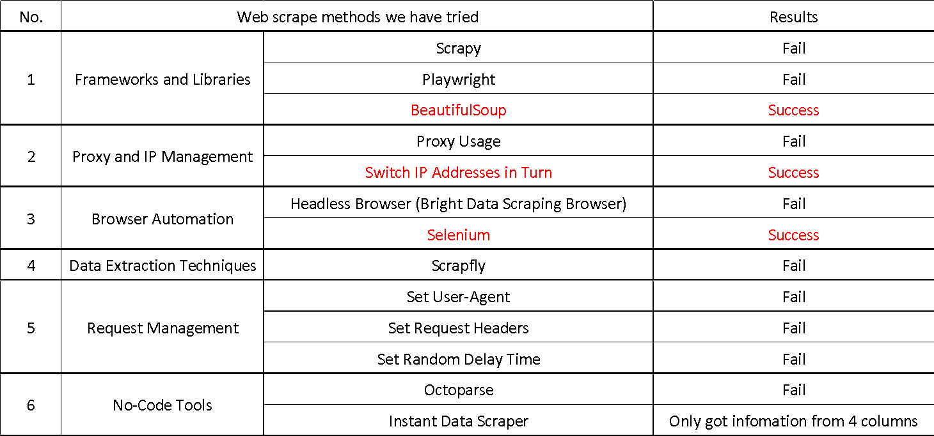
Scraping of Product Information
Bot Detection: iHerb product pages detect bots using XParameter

Slide 7
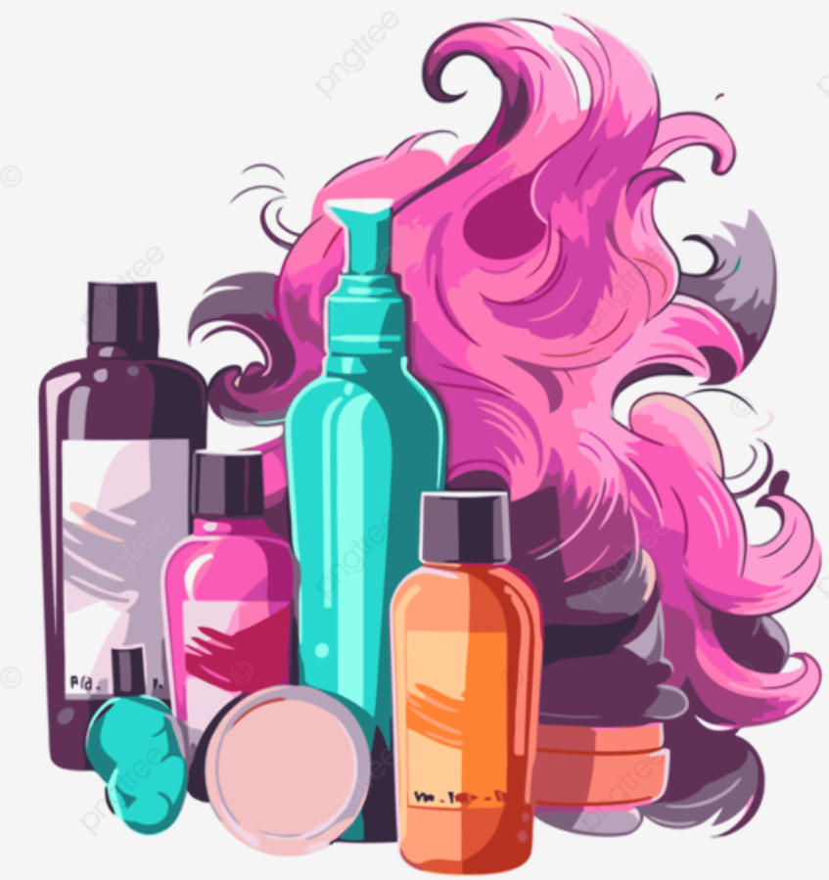
Scraping of Product Information
Solution: A semi-manual script was implemented as a workaround.
Product Links: Scraped links for 630 targeted products and saved them in a CSV file.
Removed the corresponding product link from the Product Link CSV after successful scraping.
If scraping failed, the link remained for future attempts.
IP addresses Management: Changed IP addresses using VPN and recalled the scraping function until data was successfully collected for all 630 product links.

Slide 8
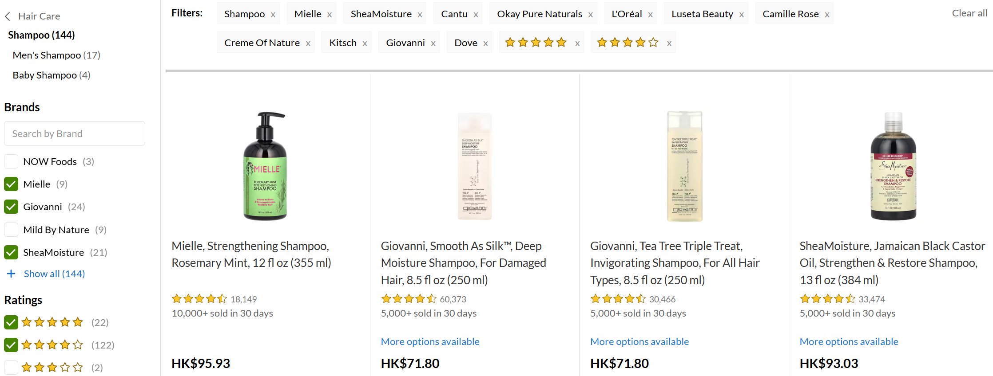
Introduction of Dataset
- Source of dataset: Hair Care • Natural Hair Care Products | iHerb
- Product information:
Selection Criteria: 630 products from 4 main categories and 11 well-known brands, each with over 40 hair care products, all rated 4 or 5 out of 5.
Categories | Number of products | Percentage
Conditioner | 196 | 31%
Shampoo | 149 | 24%
Treatments | 144 | 23%
Styling | 141 | 22%

Slide 9
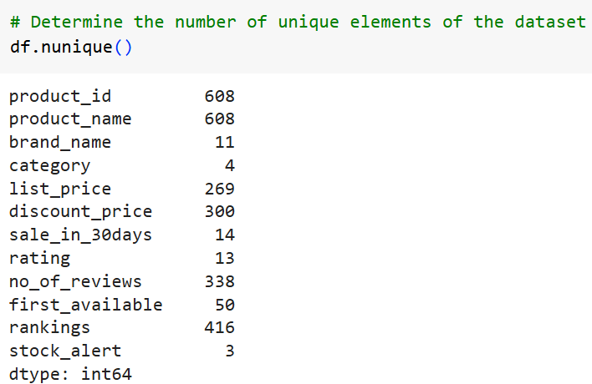
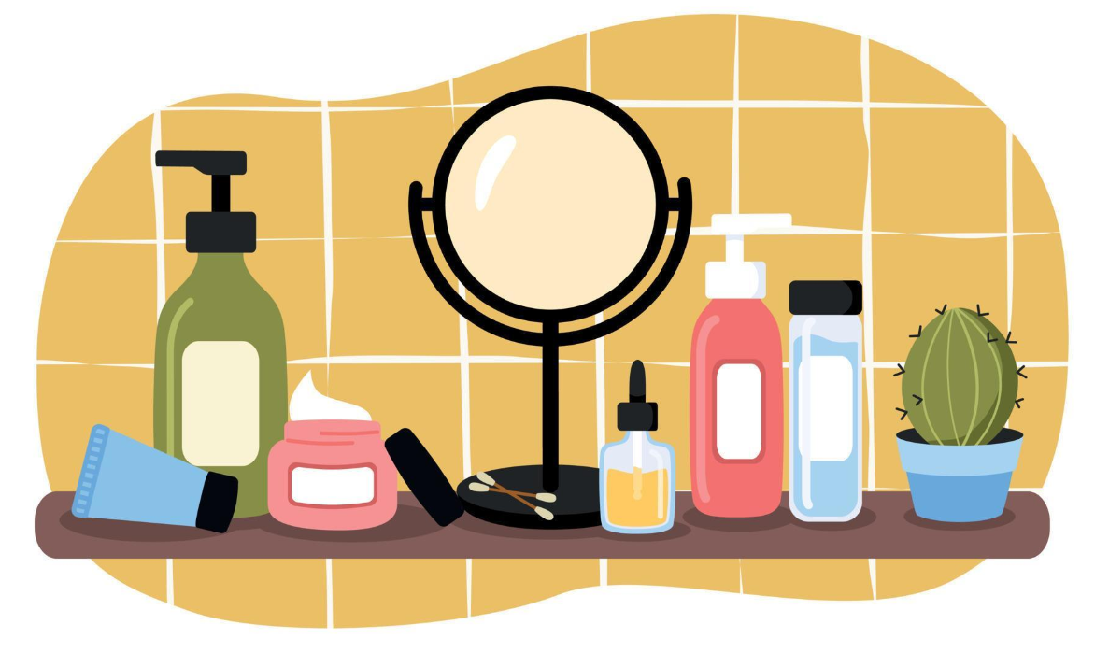
Dataset Overview (Product information)
Total Records: 630 (12 columns)
Unique Products: 608
Duplicates: 22 (due to multi-category classification)
Retention Reason: To analyze product distribution across categories.

Slide 10
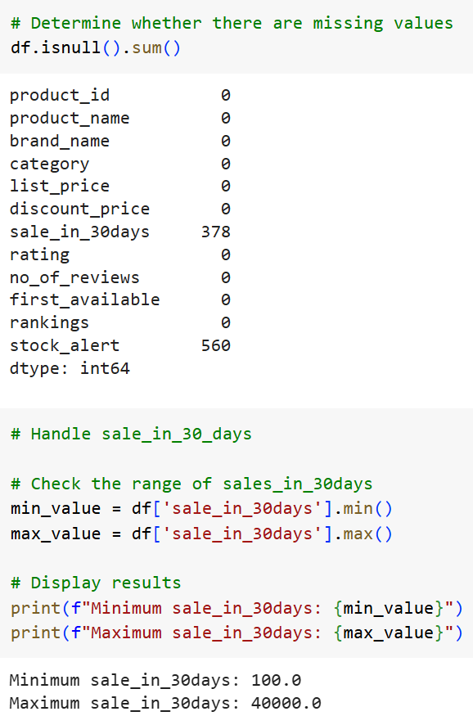
Data Preprocessing
1. Check null value
Sale in 30 days
Products with Sales Data: 40% (252/630)
Interpretation: 60% had no sales in 30 days (378/630)
Sales Range: 100 to 40,000
Action Taken: Filled missing records with 0

Slide 11
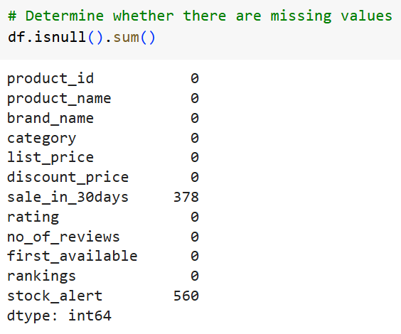
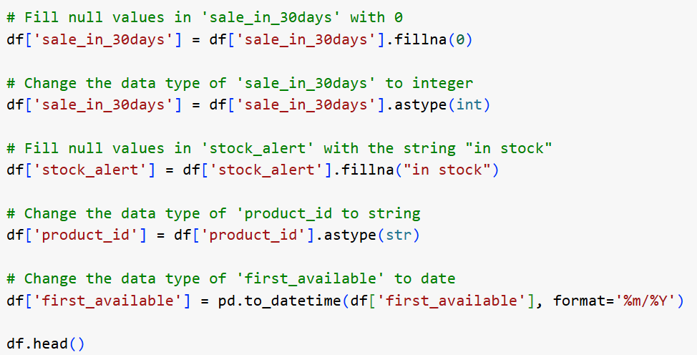
Data Preprocessing
Stock alert
Action Taken: Fill null values in 'stock_alert' with the string "in stock"

Slide 12
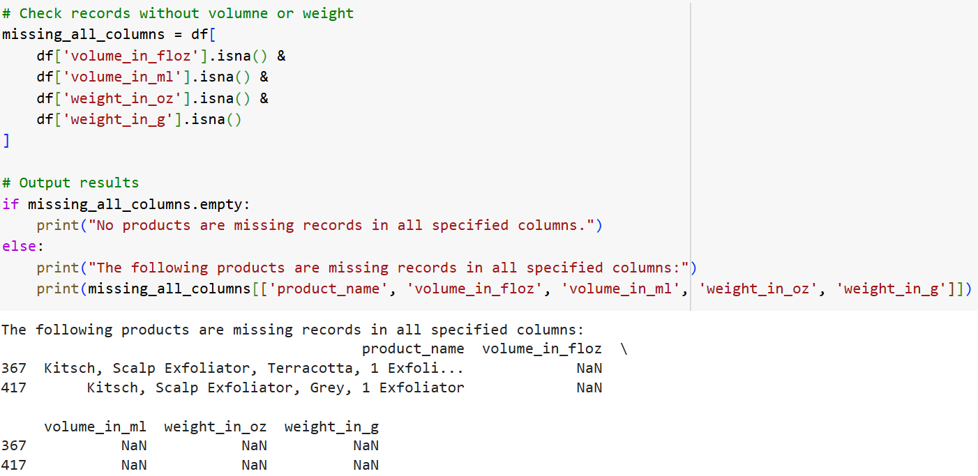
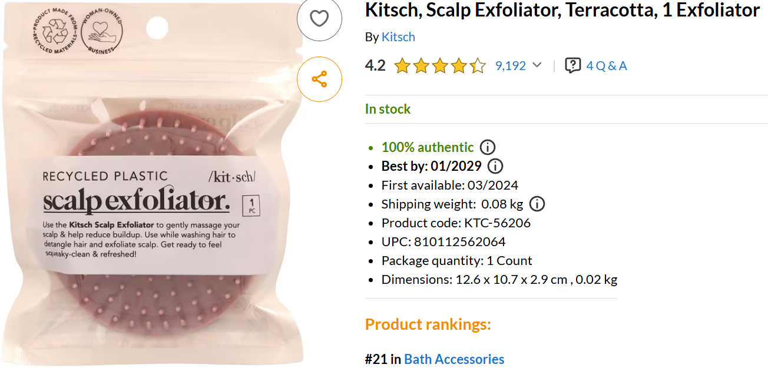
Data Preprocessing
2. Check records without volume or weight and drop 2 products

Slide 13
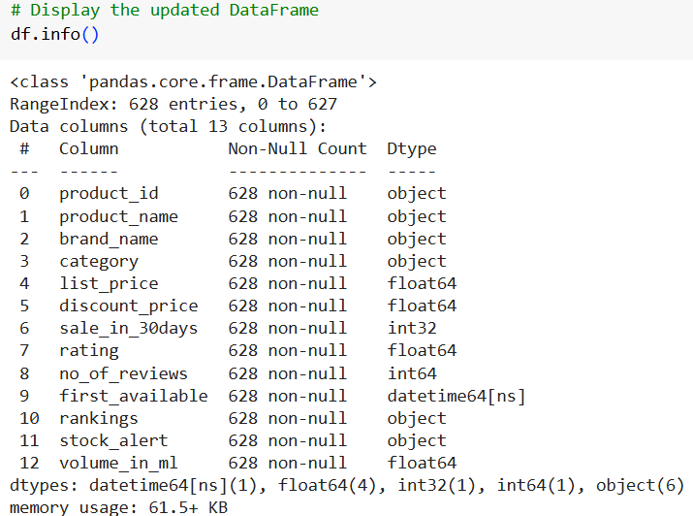
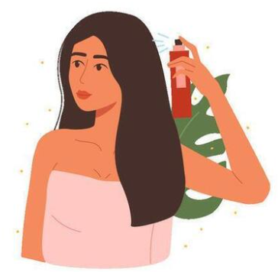
Data Preprocessing
3. Standardization capacity and Create a new column
Volume in ml
floz = ml
g = oz

Slide 14
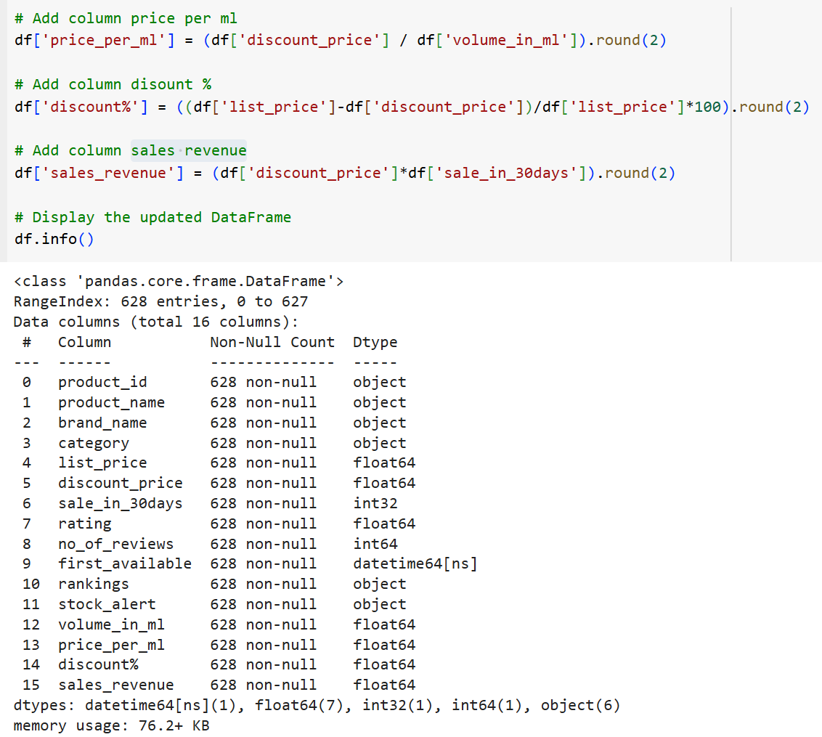

Data Preprocessing
4. Create 3 more new columns
Price per ml
Discount %
Sales revenue

Slide 15
Raw Dataset (Product information)
Categorical
Numeric
1. Brand name
2. Product name
3. Category
4. First available
5. Stock alert
6. Rankings
Product ID
List price
Discount price
Sale in 30days
Rating
No. of reviews

Slide 16
Clean Dataset (Product information)
Create new columns
Categorical
Numeric
1. Brand name
2. Product name
3. Category
4. First available
5. Stock alert
6. Rankings
only take the necessary columns:
ranking_shampoo
ranking_conditioner
ranking_hair_treatments
ranking_hair_styling
Product ID
List price
Discount price
Sale in 30 days
Rating
No. of reviews
Volume in ml
Price per ml
Discount %
Sales revenue

Slide 17
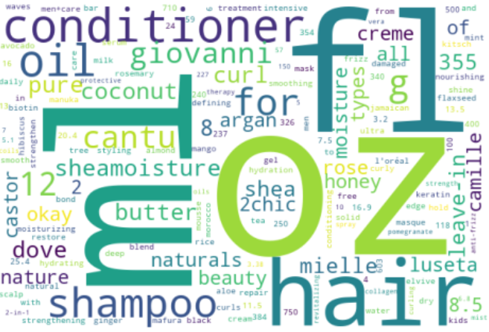
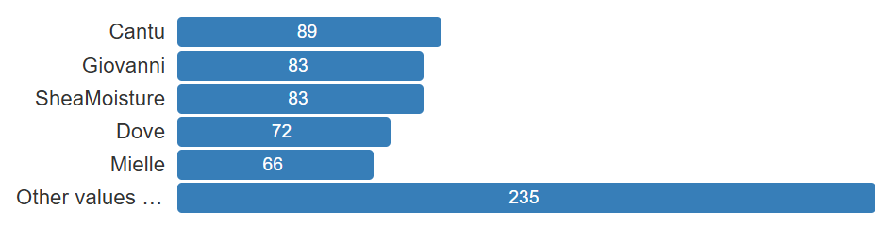
Data Exploration
5 brands that account for a relatively large number of datasets.

Slide 18
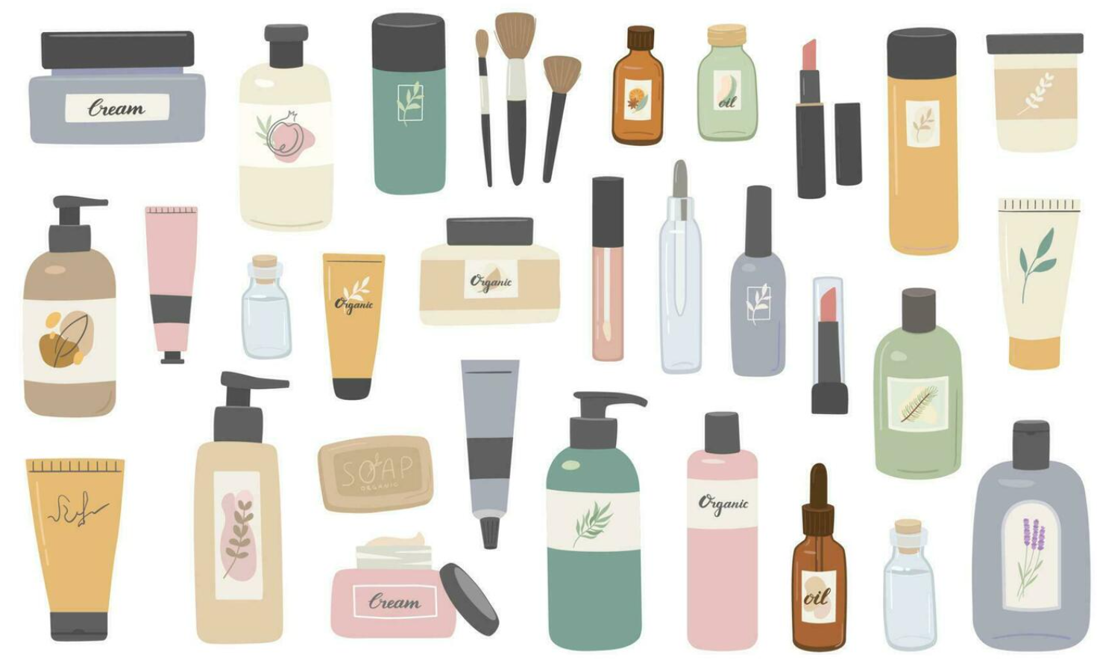
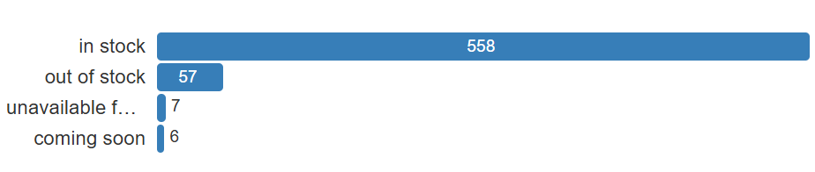
Data Exploration
Stock alert situation
Nearly 90% : in stock
9% : out of stock
1% : unavailable in Hong Kong

Slide 19

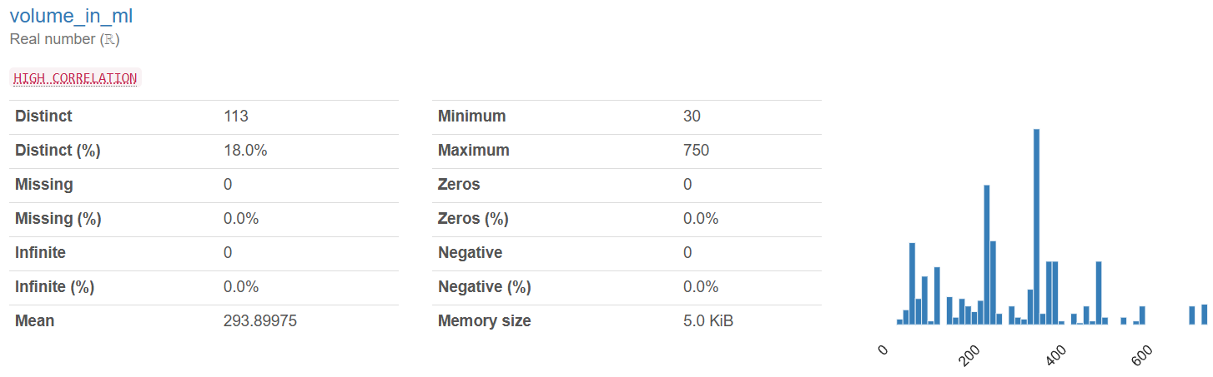
Data Exploration
Volume in ml
Mean: 294
Max : 750 (about 2.5 times higher than average)

Slide 20
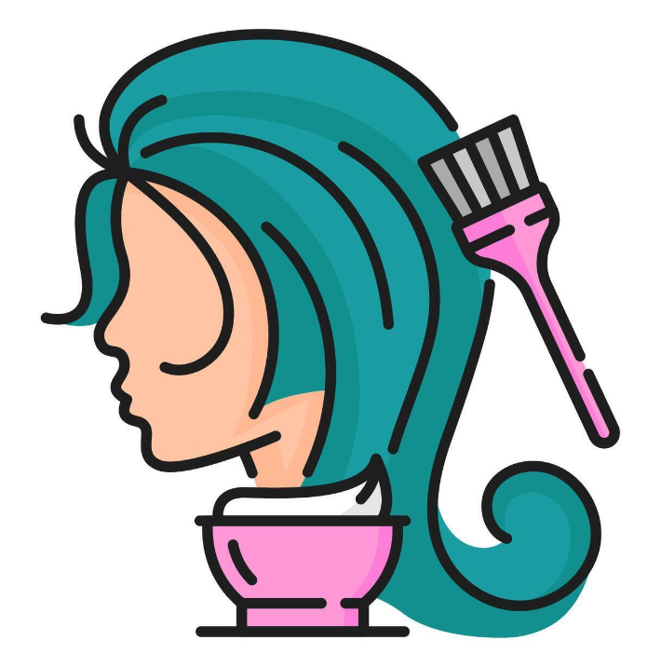
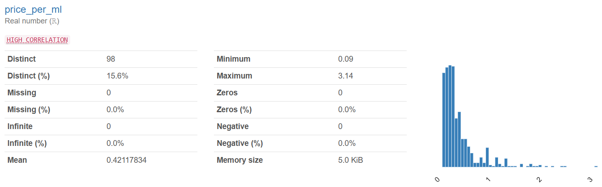
Data Exploration
Price per ml
Mean: 0.42
Max : 3.14 (about 7 times higher than average)

Slide 21

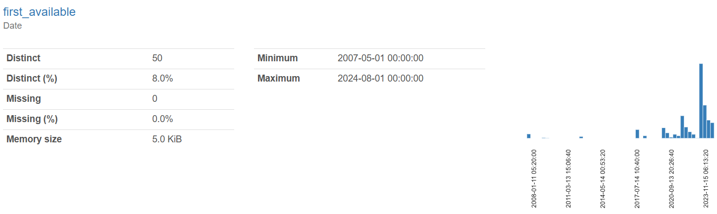
Data Exploration
A big gap in first available date.

Slide 22

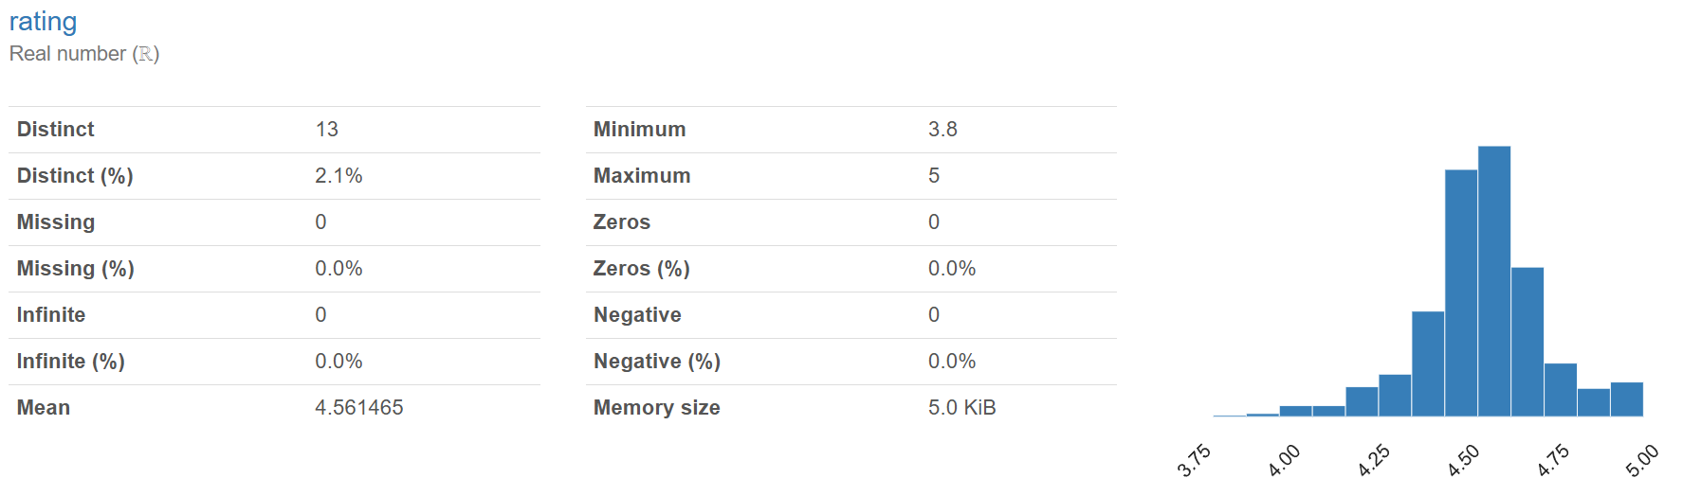
Data Exploration
Rating
Mean: 4.56

Slide 23
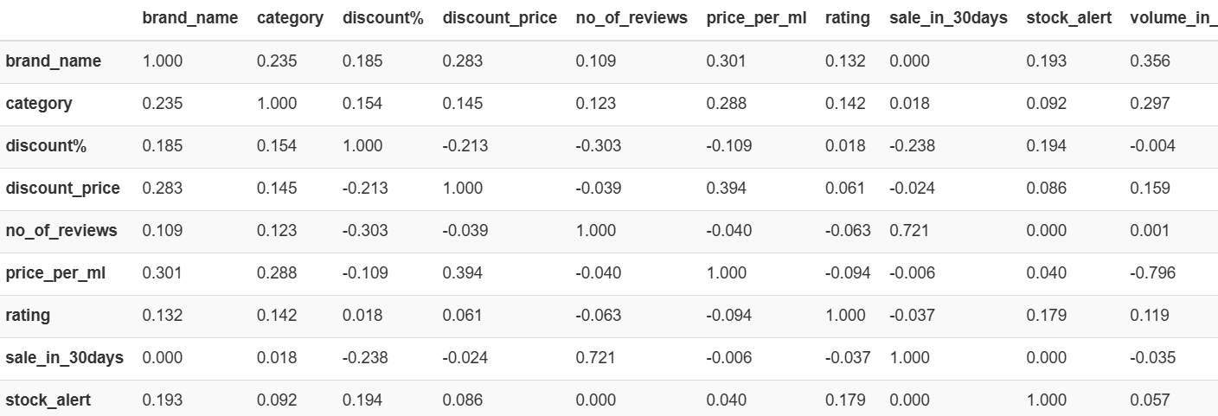
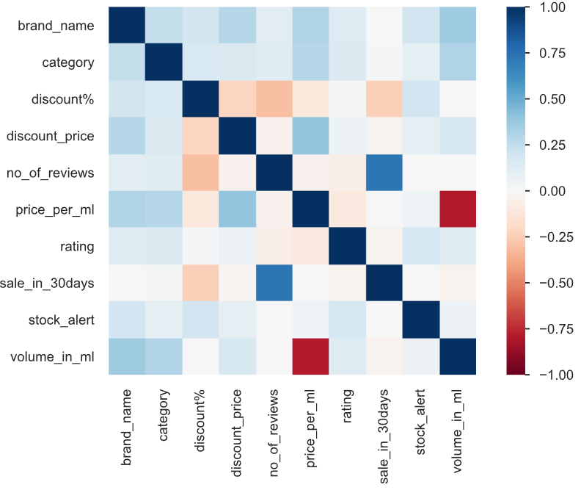
Heatmap
1. No. of reviews is inversely proportional to discount% (-0.303)
Fewer reviews result in greater discounts.
2. Price per ml is influenced by brand (0.301)
Some brands are notably more expensive.
3. Discount price (product prices) is proportional to price per ml (0.394)
Higher product prices lead to higher unit prices.

Slide 24
Heatmap
4. Volume in ml is highly correlated with price per ml (-0.796)
Product volume increases, the price per milliliter tends to decrease.
5. No. of reviews is highly correlated with sale in 30 days (0.721)
As the number of reviews increases, sales tend to increase as well.

Slide 25
Data Visualization
with a Dashboard

Slide 26
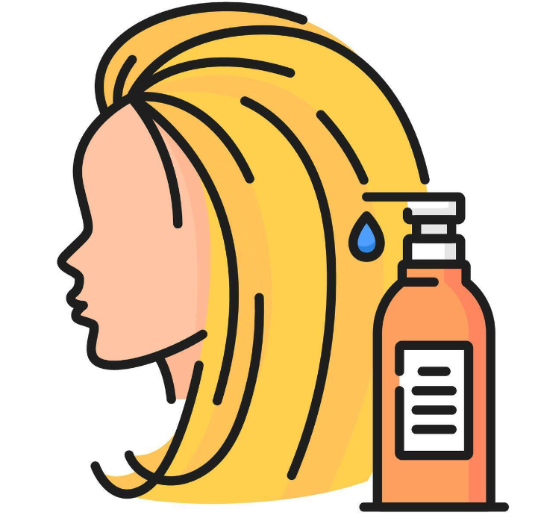
Dashboard
Sales Revenue = product price*sale in 30 days
Popularity = rating*no. of reviews / first available date of the products to 2024/9/30
The Popularity Score offers a balanced view of product appeal by combining average user ratings with the number of reviews and time since availability.
This metric helps to:
Mitigate Rating Bias: High ratings alone can misrepresent a product's popularity.
Reflect Trendiness: It captures genuine popularity trends beyond just raw ratings.
Provide Comprehensive Insights: By factoring in average ratings, review counts, and the duration of availability, it reveals a clearer picture of a product's market standing.

Slide 27
Sentiment Analysis on Customer Reviews

Slide 28
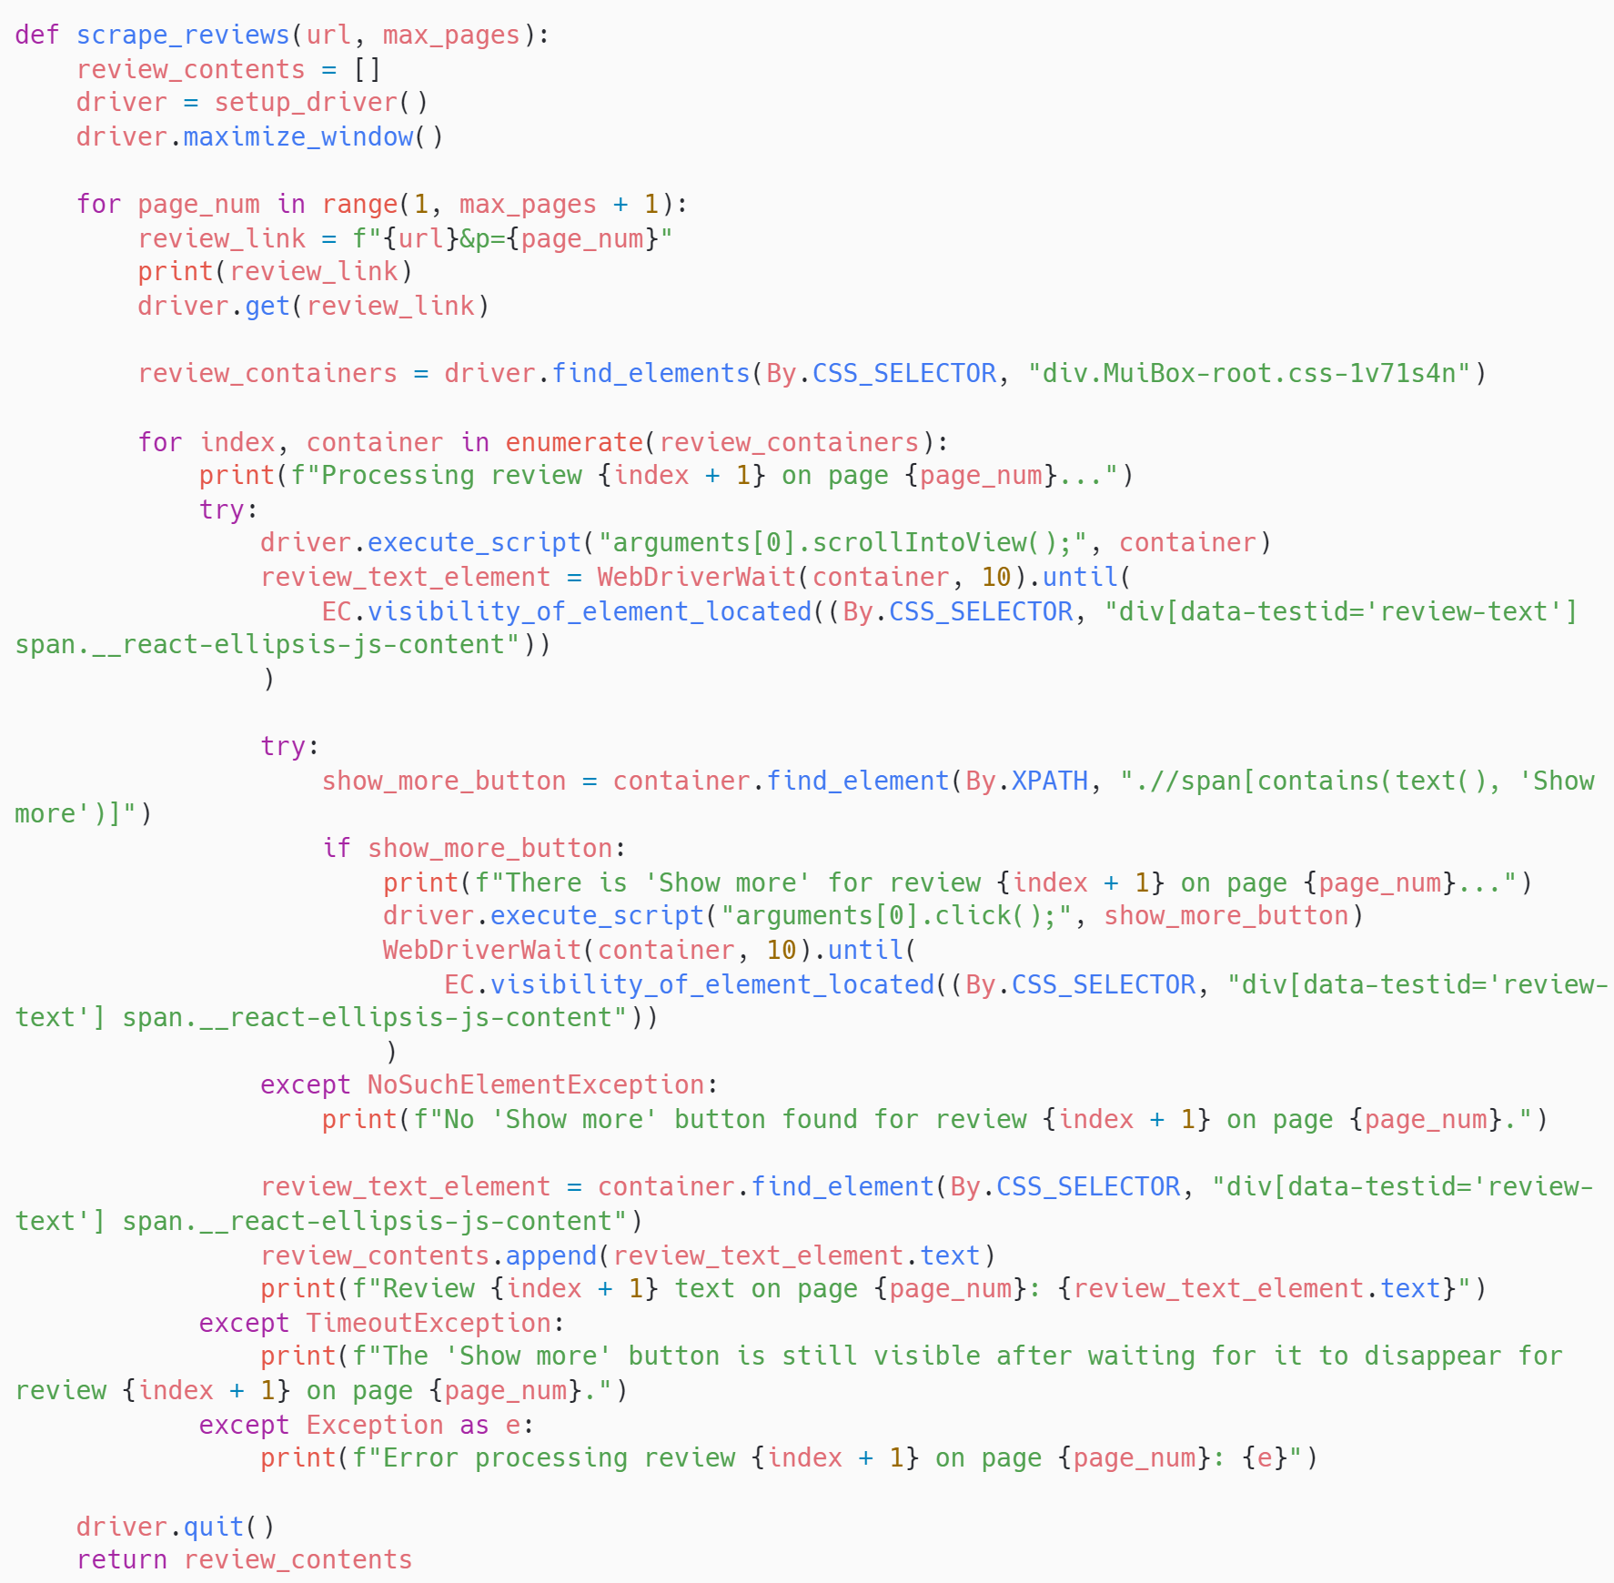
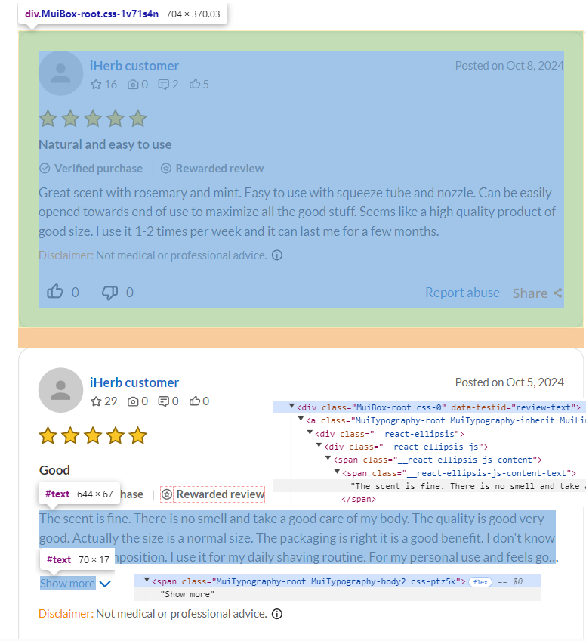
Scraping of Customer Reviews
1. Locate all ten review containers in a page
2. Expand reviews if necessary by clicking “Show more”
3. Capture the text of each review

Slide 29
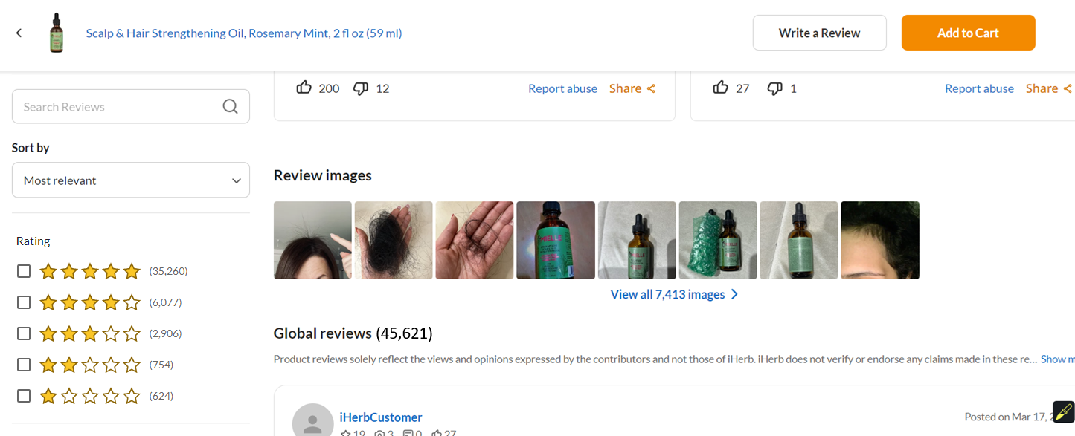
Introduction of Reviews Dataset
Selection Criteria: Over the past 30 days and among the 11 well-known brands, the best-selling product in each of the 4 categories (Shampoo, Conditioner, Treatments, Styling)
Data Captured: Customer reviews based on rating ratios
Total Reviews Collected: 250 reviews * 4 best sellers = 1,000 reviews
3 columns: product_id, rating, review_text
5 stars | 4 stars | 3 stars | 2 stars | 1 star
193 | 33 | 16 | 4 | 4
Sample 250 reviews for each best seller that reflect the ratio of ratings

Slide 30
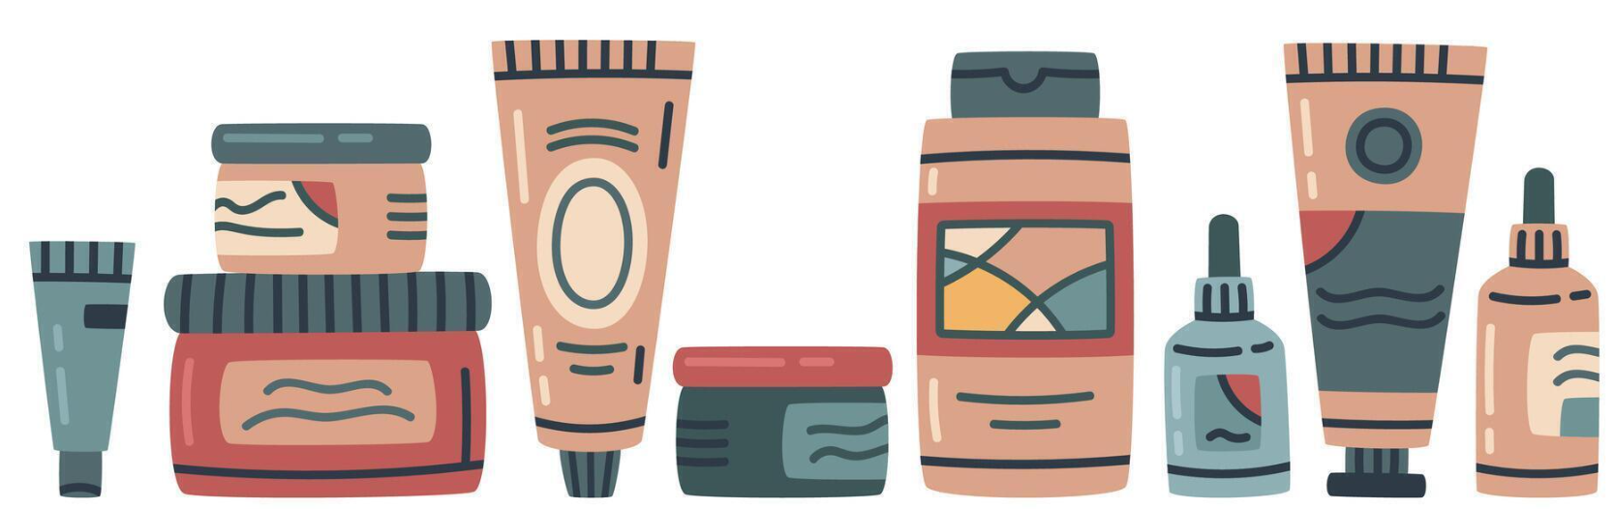
Text Preprocessing
Emoji Conversion: Convert emojis to their official descriptions to standardize the text
Lowercasing: Normalize all text to lowercase to ensure uniformity
Special Character Removal: Remove unnecessary special characters like ,.:;@#^&_+-*/<>(){}®=…, while preserving emotive punctuations like ! ?
Stopword Removal: Remove stopwords that do not carry significant meaning to reduce noise in the text
Spelling Correction: Correct spelling errors using TextBlob to improve text quality
Lemmatization: Reduce words to their base or root form using lemmatization to normalize variations

Slide 31
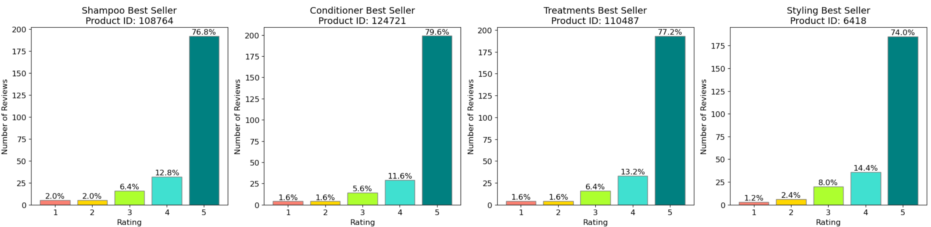
Rating Distribution
108764: Mielle, Strengthening Shampoo, Rosemary Mint
124721: Mielle, Strengthening Conditioner, Rosemary Mint Blend
110487: Mielle, Scalp & Hair Strengthening Oil, Rosemary Mint
6418: Giovanni, L.A. Hold Styling Gel, Strong Hold

Slide 32

Word Clouds by Rating
Analysis Plan:
Collective analysis: Shampoo, Conditioner and Treatments
Individual examination: Styling product
Visualization: Generate word clouds for each group based on rating scales
(i) Ratings 4 to 5
(ii) Rating of 3
(iii) Ratings 1 to 2

Slide 33
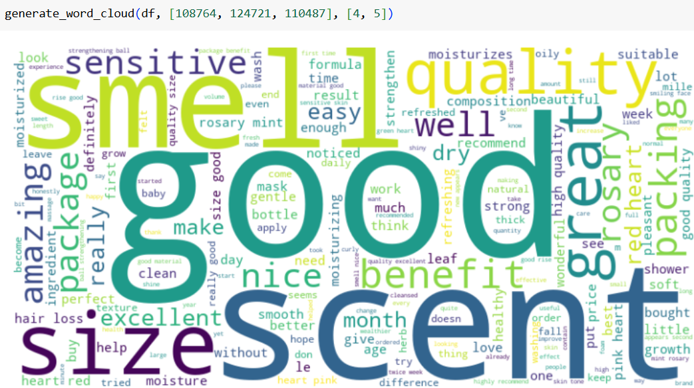
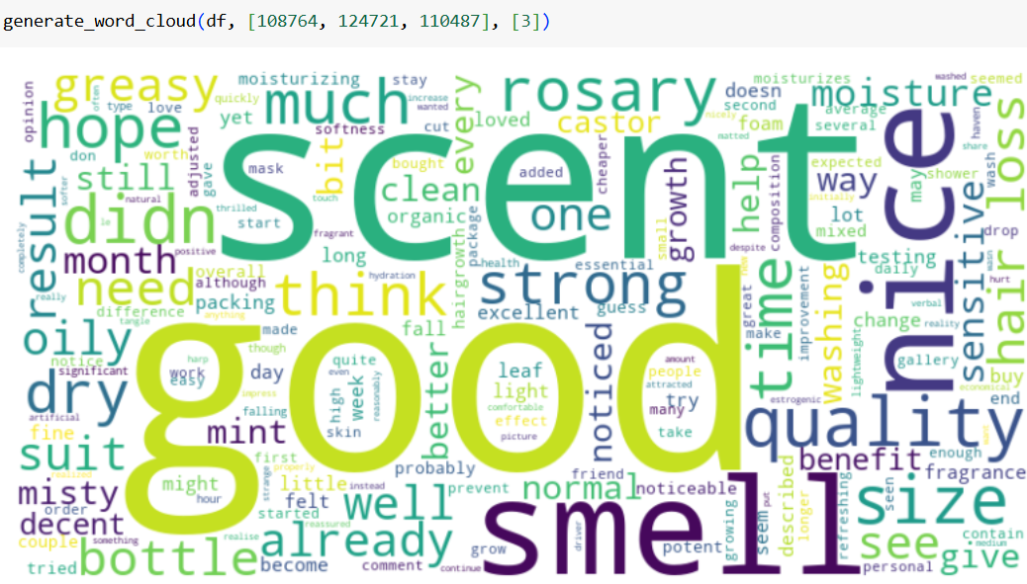
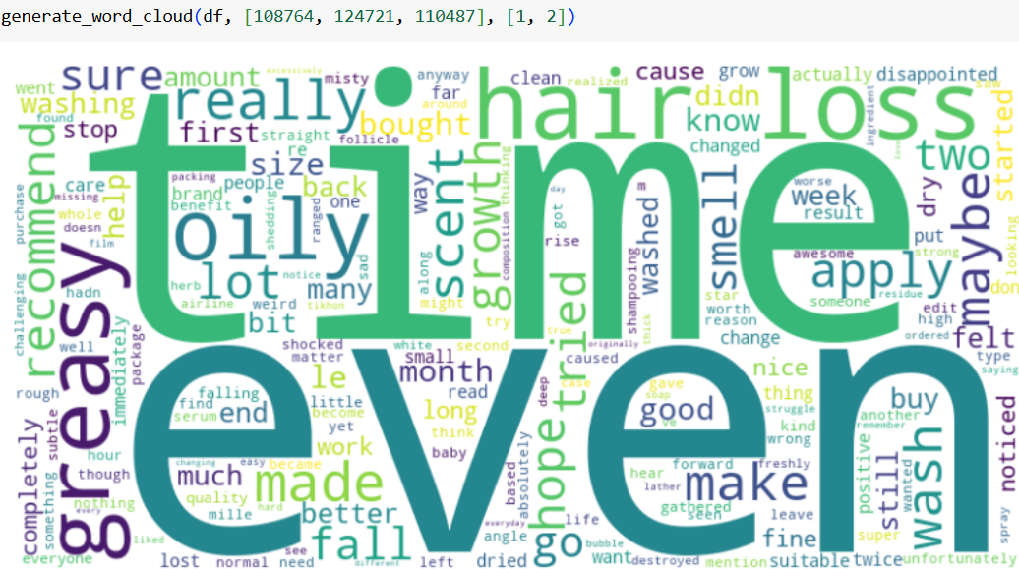
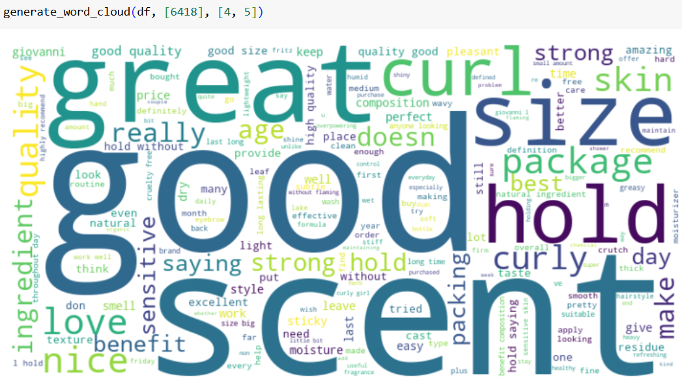
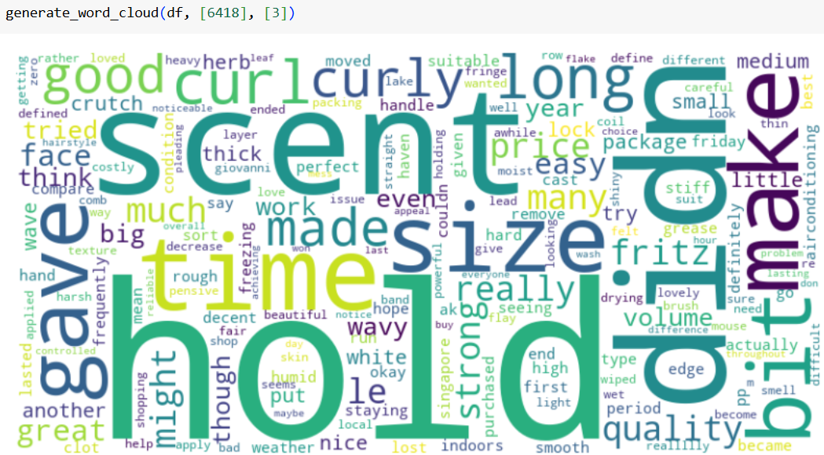
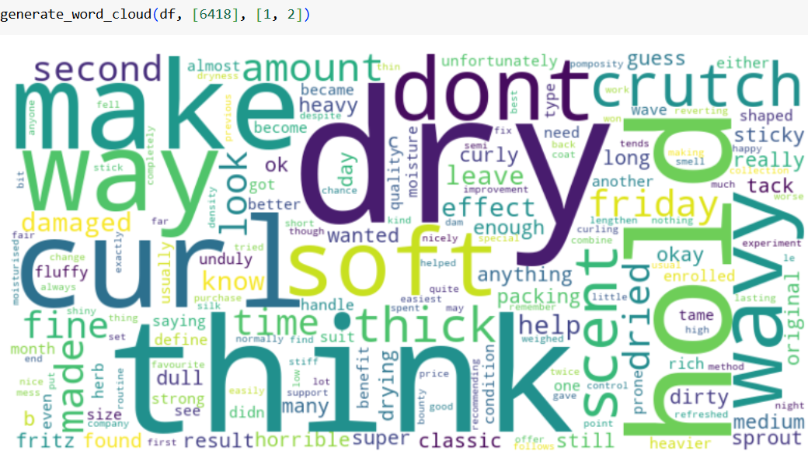
Word Clouds by Rating
Mielle, Strengthening Hair Products, Rosemary Mint (Shampoo, Conditioner, Treatments Best Sellers)
Giovanni, L.A. Hold Styling Gel, Strong Hold (Styling Best Seller)

Slide 34
Approaches used for Sentiment Analysis:
NLTK VADER (Valence Aware Dictionary and sEntiment Reasoner)
A lexicon and rule-based sentiment analysis tool: a list of words with associated sentiment scores, along with a set of rules to evaluate the sentiment of text, specifically for social media contexts
'pos', 'neu', and 'neg' scores: the proportion of text that falls into each category (sum up to 1)
'compound' score: a normalized composite score ranging from -1 (most negative) to +1 (most positive)
Huggingface RoBERTa Transformers
Deep Learning-Based Pre-trained Model: Uses multiple layers of Transformer architecture to learn complex features and patterns from text
Generation of logits: raw scores that represent the model's preliminary assessment of the input text
Normalization with Scipy’s Softmax: into probabilities ranging from 0 to 1
Positive, neutral, negative sentiment scores (sum up to 1): the model’s confidence level that the input text belongs to a particular sentiment class

Slide 35
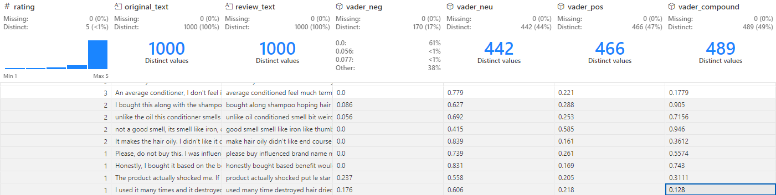
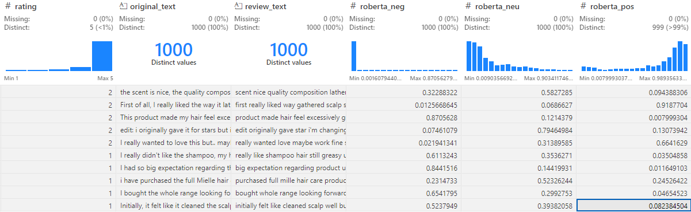
To our surprise, both approaches do not perform well on the preprocessed text,
especially in scoring sentiment on reviews with low ratings.

Slide 36
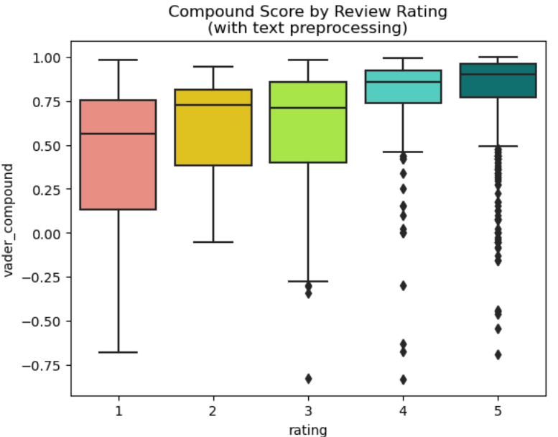
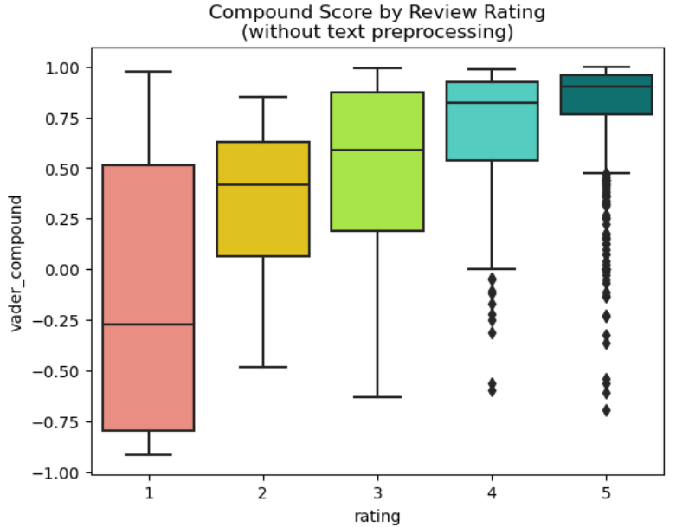
Sentiment Analysis using VADER

Slide 37




Sentiment Analysis using VADER
1- star rating with the highest positive sentiment score
With text preprocessing:
Unwanted correction of spelling
Unexpected removal of negation words
Without text preprocessing:
lower vader_pos: improvement
5- star rating with the highest negative sentiment score
With text preprocessing:
Without text preprocessing:

Slide 38
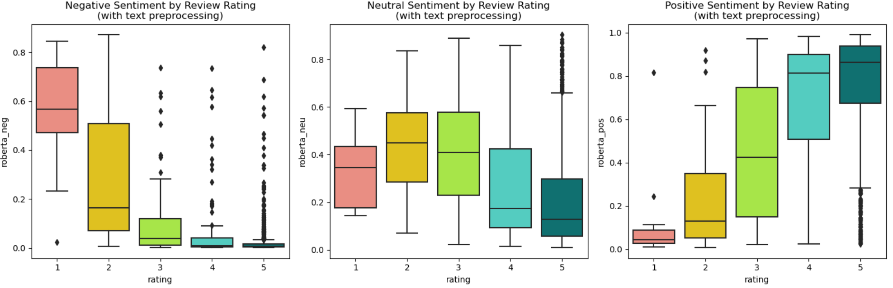
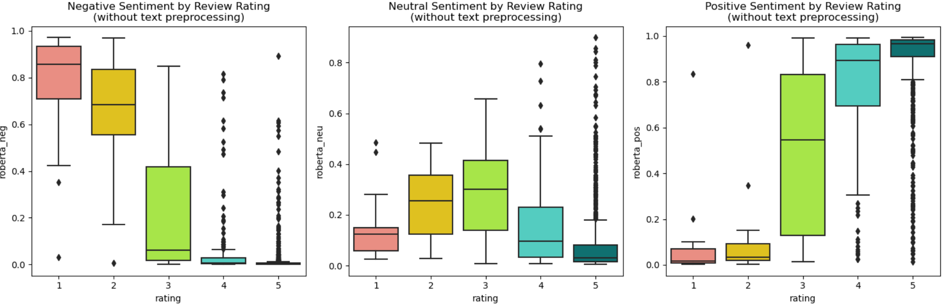
Sentiment Analysis using RoBERTa
With
text preprocessing
Without
text preprocessing

Slide 39

Sentiment Analysis using RoBERTa
1- star rating with the highest positive sentiment score
With text preprocessing:
Majority of the text carries positive sentiment; may not be sensitvie the negative sentiment in small proportion
roberta_pos: 0.8160131573677063
Original Text: Now I finally understand the hype! After 3 months of using it I can see baby hair growing out! Noticed a little bit of difference in hair loss but I keep my hopes up after some time! The scent is subtle and doesn’t bother me. My scalp is less itchy. The size is really good and goes for a while if you’re oiling two times to 3 times a week. Looking forward to seeing more improvements in my hair for the next 3 months! Edit; my hair went crazy! I realized it is so heavy for my hair. Became so greasy on the scalp yet so frizzy too! Hair loss increased so I stopped using it.
Preprocessed Text: finally understand hope! 3 month using see baby hair growing out! noticed little bit difference hair loss keep hope time! scent subtle doesn’t bother scalp le itchy size really good go you’re boiling two time 3 time week looking forward seeing improvement hair next 3 months! edit hair went crazy! realized heavy hair became greasy scalp yet friday too! hair loss increased stopped using
Without text preprocessing: same text with similar score
5- star rating with the highest negative sentiment score
With text preprocessing:
Reasonable as seen from its small negative sentiment score
Without text preprocessing:
Reasonable as the review contains mostly negative wordings
roberta_neg: 0.8923622965812683
Text: Ohhh I red so many unbelievable reviews but unfortunately it didn’t work for me… First of all the hair gets so greasy and you can only use it if you are home… maybe I was doing something wrong but definitely not for me … the scent is very specific the rest was ok, the package arrived well and the size is good… I guess it’s just not for me

Slide 40
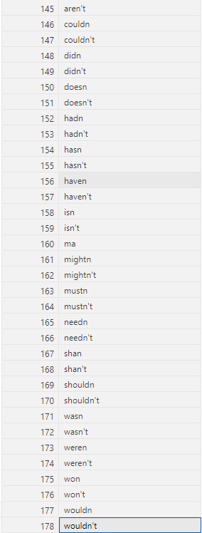
Possible reasons why both approaches perform better without text preprocessing:
VADER:
Relies on Lexical Cues: Direct sentiment indicators like emojis and slang.
Emoji and Emoticons Interpretation: capable of understanding emojis and emoticons
Punctuation Sensitivity: Uses punctuation for sentiment intensity
Capitalization: May use it as a signal for emphasis
RoBERTa:
Contextual Awareness: Needs original text structure for context.
Intact Syntactic Cues: Depends on natural syntax for accurate analysis
Lowercasing: May make it harder for the model to identify contextual clues
Our findings:
The NLTK library's list of stopwords includes negation words (as shown on the left), which play a crucial role in sentiment analysis. Stripping these words from the text during preprocessing could adversely affect the accuracy of both VADER and RoBERTa.

Slide 41
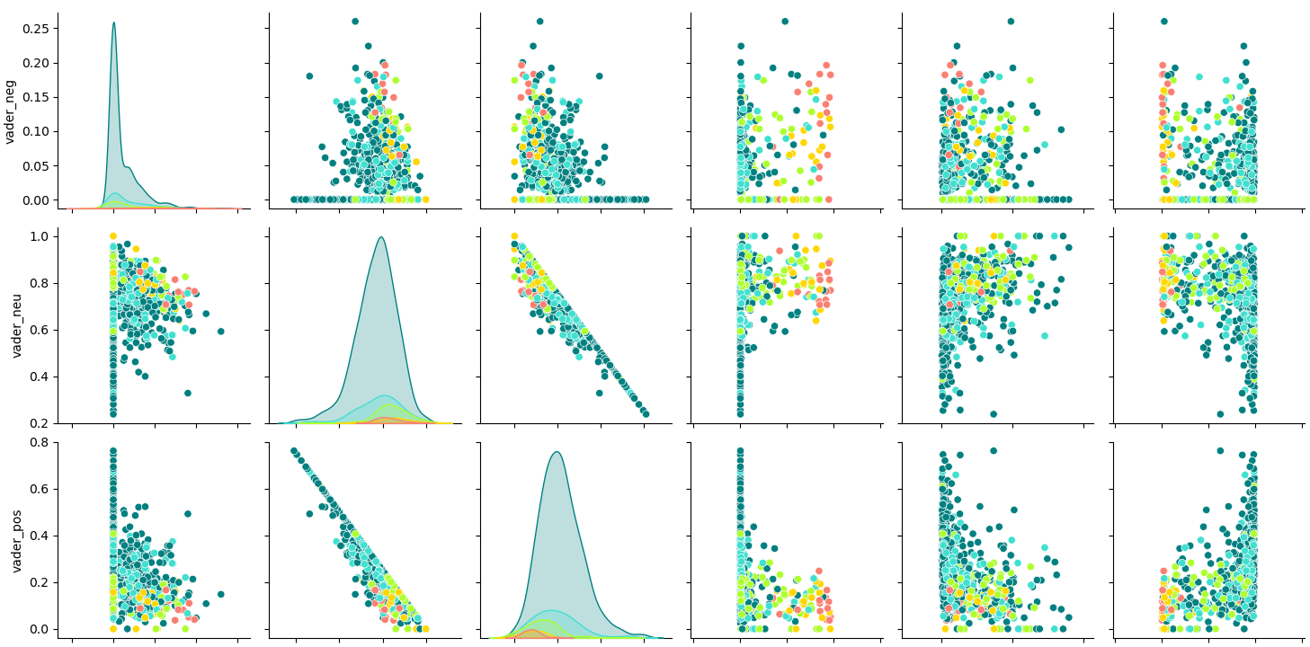
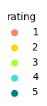

VADER VS RoBERTa

Slide 42
RoBERTa:
More concentrated distribution (Points are tightly clustered)
Consistent performance across different metrics (Less variability)
Demonstrate more reliable performance

Slide 43

Insights from reviews
Customize sentiment classification thresholds:
Positive: pos > 0.75 and neg < 0.25
Mild Positive: pos > 0.5 and neg < 0.5
Neutral: pos < 0.25 and neg < 0.25 and neu > 0.5
Negative: neg > 0.75 and pos < 0.25
Mild Negative: pos < 0.5 and neg > 0.5
Mixed: Any instance that doesn’t meet the criteria for the above categories (pos and neg are moderate; both around 0.3 to 0.5)

Slide 44


Sentiments by Rating

Slide 45
Based on our analysis, we examined the most positive, the most negative, as well as mixed reviews.
We found that mixed reviews are more reliable because
Balanced View: Capture a mix of positive and negative aspects
Detailed Feedback: Provide more detailed and specific details on product features
Realistic Expectations: Able to set accurate expectations for potential buyers
Trustworthiness: Seen as more credible and less biased, neither overly optimistic nor pessimistic
Influence of Ambiguity: Reflect varying outcomes based on individual preferences or use cases

Slide 46
Conclusions

Slide 47

Conclusions
Mielle has the best sales in the past 30 days, with 3 of the 4 product categories ranking first.
SheaMoisture, Giovanni and Mielle have four product categories on the best-selling list, which can be bundled into a series to sale to improve performance.
Cantu’s sales performance in hair styling is relatively good.
Consumers are most willing to spend money on treatments and are least willing to spend money on styling products.
Consumers like good scent hair care products with great size.
In shampoo, conditioner and treatments, hair loss, greasy and oily products are not popular with consumers.
Consumers use styling products to hold the hairstyle or keep their hair curly, but don’t want their hair to become dry after use.

Slide 48
Conclusions
Dove demonstrates poor sales performance on the iHerb platform.
Dove did not rank as a best-seller. The dataset includes 72 Dove products, but 56 (or 78%) had zero sales in the past 30 days. Additionally, Dove's highest popularity score is only 2.
There are 7 products rated 4 stars or above that are not available in Hong Kong.
It is recommended to introduce these products to develop the Hong Kong market.

Slide 49
Conclusions
It is essential to understand the requirements of various sentiment analysis approaches and select the appropriate text preprocessing techniques.
RoBERTa has better peformance in our dataset

Slide 50

Limitations & Challenges
Limitations
Less key information available
˙ such as repeat purchases and customer loyalty metrics
Imbalanced distribution of ratings, heavily skewed towards high ratings
˙ hinders the development of robust models for machine learning applications
Challenges
Web scrapings
˙ need to use various methods to break through anti-crawler measures on the iHerb website
2. Dataset selection
˙ initially had different opinions on the theme, leading to delays due to an overload of ideas

Slide 51

Future Work
A more comprehensive analysis
- analyze lower-rated products (one-star and two-star)
Year-over-year comparisons
- comparison of sales of various brands in recent years
- changes in best sellers in recent years
Create a customized list of stopwords to enhance sentiment analysis
- preserving negation words
Train sentiment models using a balanced dataset
- aiming to address overfitting issues

Slide 52
Reference
Dataset:
https://hk.iherb.com/c/hair-care
Use WebDriver to automate Microsoft Edge:
Use WebDriver to automate Microsoft Edge - Microsoft Edge Developer documentation | Microsoft Learn
How to create Tooltip Pages in Power BI
https://www.youtube.com/watch?v=npaQ42K1sTs
Instant Data Scraper & Octoparse
https://www.youtube.com/watch?v=0xzTzw6GQiw&t=87s
NLP & Sentiment Analysis Tutorial
https://www.kaggle.com/code/furkannakdagg/nlp-sentiment-analysis-tutorial

Slide 53
Thank you
&
welcome any questions

